Slide 1

Lead Scoring Case Study using logistic regression
Shrivallabh Deshmukh

Slide 2
Problem statement Problem approach EDA Correlations Model Evaluation Observations Conclusion
CONTENT

Slide 3
X Education, an online course provider for industry professionals, receives daily leads from website form submissions. The sales team aims to identify potential "Hot Leads" among them to increase the lead conversion rate, focusing communication efforts on the most promising prospects. Currently, the average conversion rate stands at 30%.
- Problem statement

Slide 4
Lead X has tasked us with creating a lead scoring model to assign a score from 0 to 100 to each lead. This will enable them to identify "Hot Leads" and improve their conversion rate significantly. The CEO aims to achieve an impressive 80% lead conversion rate. Moreover, the model should be adaptable to address future constraints, such as handling peak time actions, optimizing workforce utilization, and devising appropriate strategies after reaching the target conversion rate.
- Problem approach

Slide 5
- Importing the data and inspecting the data frame - Data preparation - EDA - Dummy variable creation - Test-Train split - Feature scaling - Correlations - Model Building (RFE Rsquared VIF and p-values) - Model Evaluation - Making predictions
Problem approach

Slide 6
- Treating missing values - Treating NaN values
- Data cleaning

Slide 7
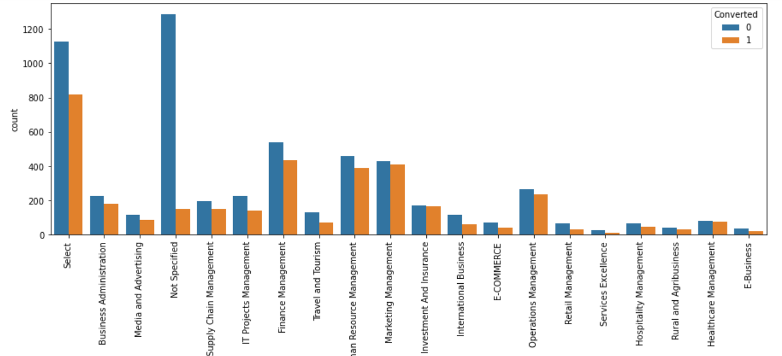
There are higher conversions in Finance, HR, and Marketing
- EDA

Slide 8
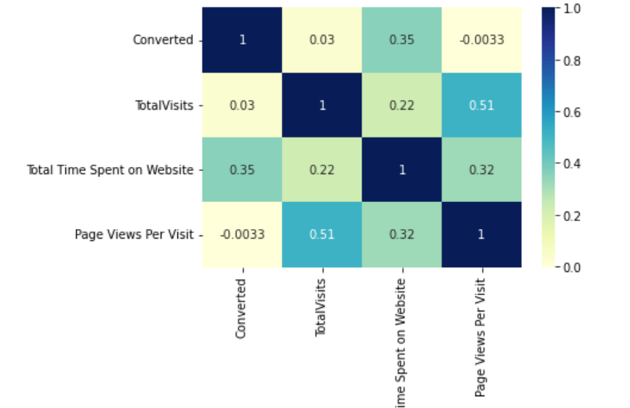
No strong correlations are present
- EDA

Slide 9
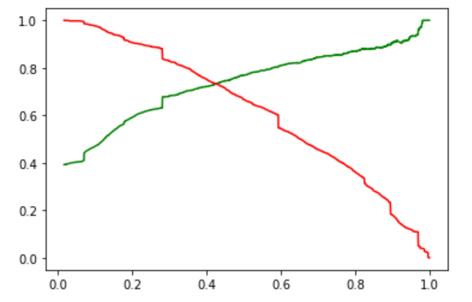
0.42 is tradeoff between precision and recall
Model evaluation

Slide 10
Lead Source_Olark Chat Lead Origin_Lead Add Form Last Activity_Olark Chat Conversation Total Time Spent on Website Lead Source_Welingak Website Last Activity_Email Bounced Last Notable Activity_Email Bounced Last Notable Activity_SMS Sent Last Activity_Email Opened Lead Origin_Lead Import Last Activity_Had a Phone Conversation Last Notable Activity_Unreachable
Final features list

